Slide 1
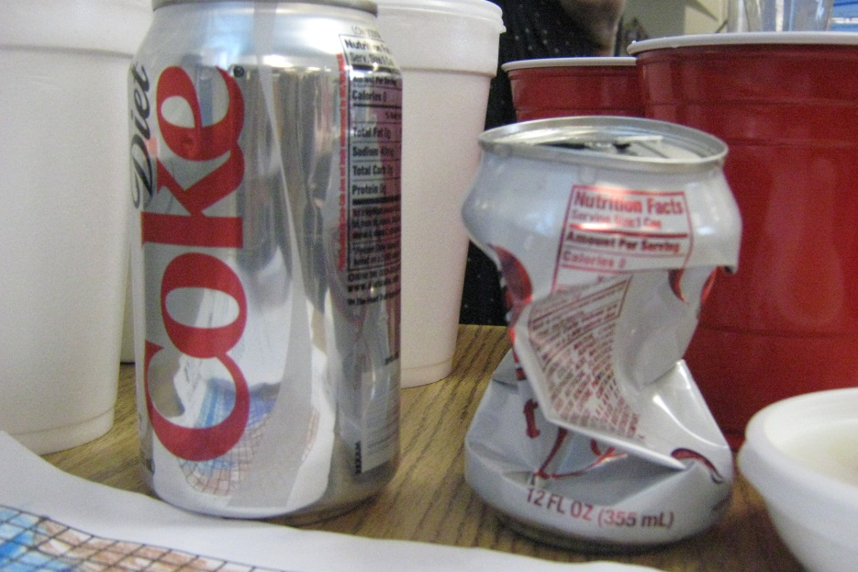
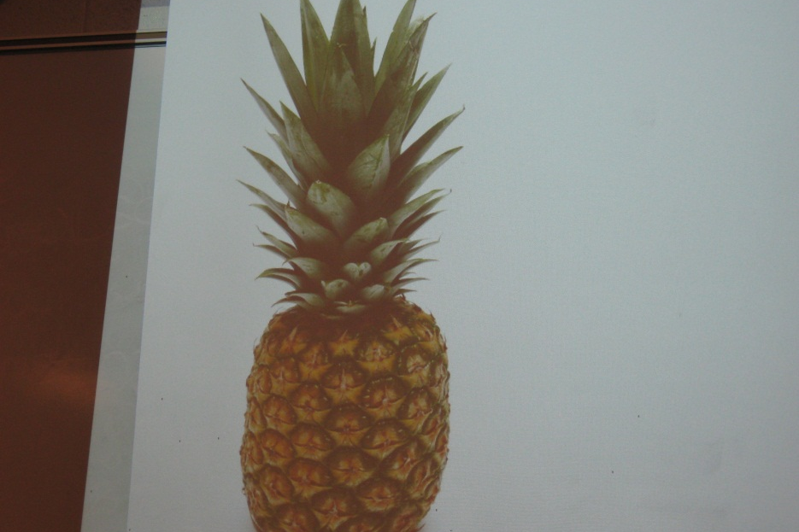
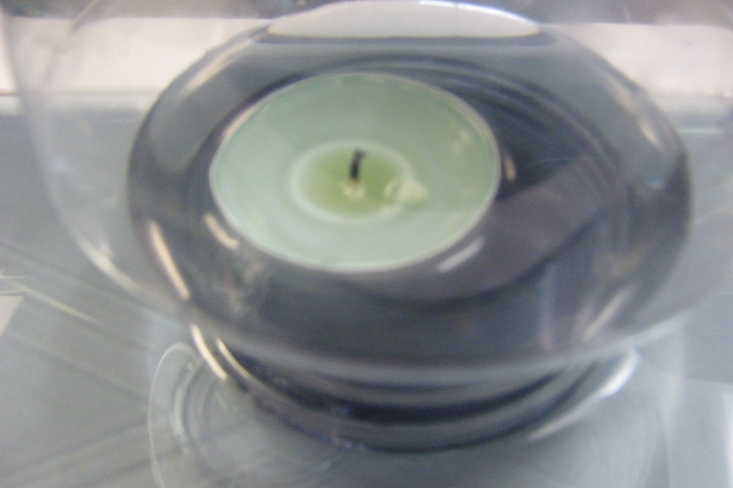
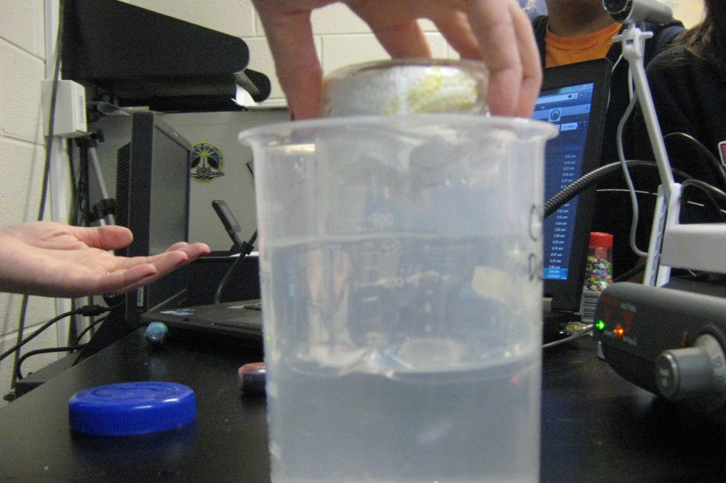
A
B
R
T
S
F
Y
H
I
L
K
Notes:
We’re going to create our own What’s the Word game. You will create slides for your three assigned words and a fourth word of choice. Here is an example question slide.

Slide 2
A
I
R
A
B
R
T
S
F
Y
H
I
L
K
Notes:
Here is an example answer slide.

Slide 3
A
B
C
D
E
F
G
H
I
J
K
Notes:
Insert your four photos. Add/subtract blank boxes for each letter of the word. Make sure the needed letters are in your alphabet tiles. Once this slide is complete, copy it and paste as a new slide. Then, type the answer in the blank boxes like in the example. Save your finished slides to Mrs. Wilson’s folder on the share drive.

